Slide 1
Optimising Developing Heart Growth Problem
Hashem Yousefi

Slide 2
Outline
Update on work done in the previous week
Issues which are not resolved
Action items from the other aspects
Plans for the following week

Slide 3
Last Week
Bringing the comparison of the results in a power-point
Checking other optimization methods in the pyOpt Module
Testing with a bigger elements for 12D space to get enough independency
Plotting the objective function for a simple 2-D case …
Writing a report for the Mesh Painting sections

Slide 4
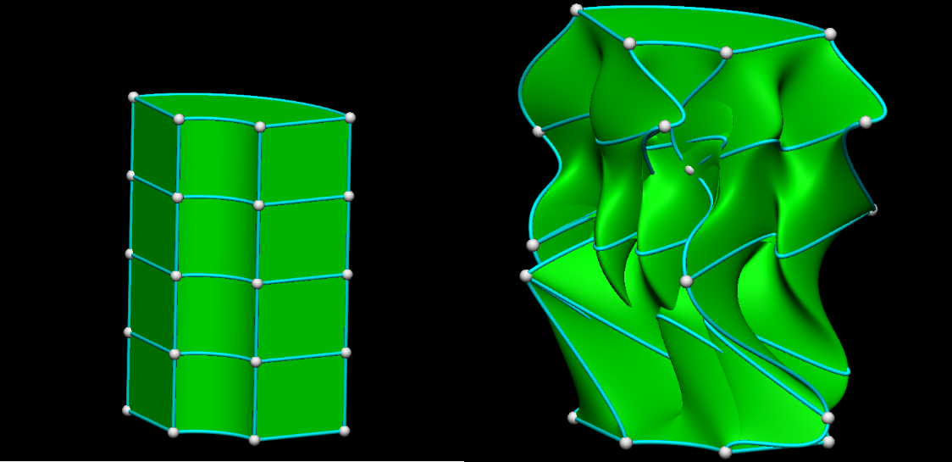
Problems

Slide 5
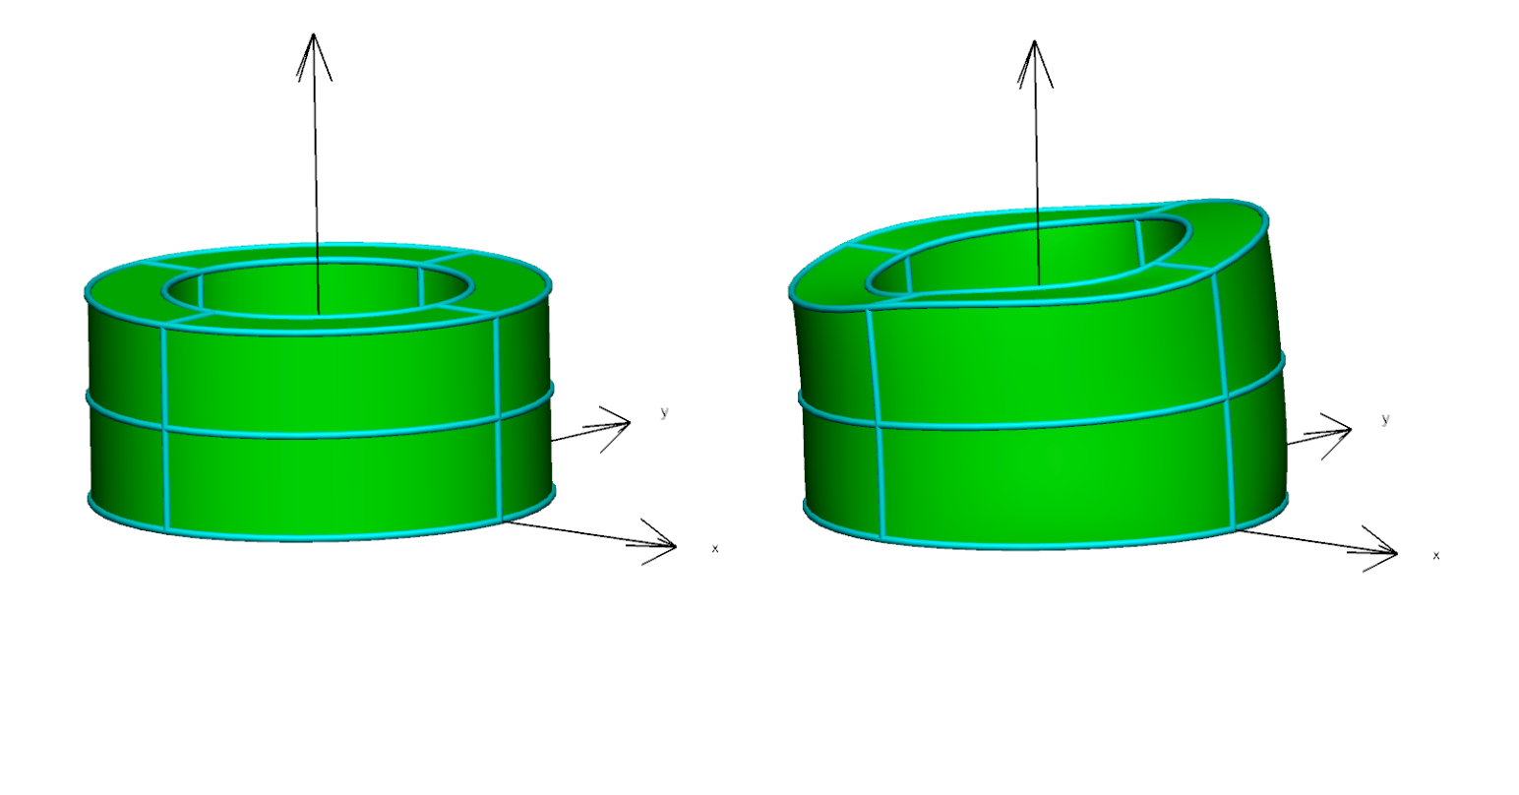
Forward Problem for 8 Elements to Test 12 Growth Rates
form of final answer
Fibre , sheet, normal
[0.0065, 0.025, 0.0001, 0.0045, 0.015, 0.0001, 0.0025, 0.005, 0.0001, 0.0045, 0.015, 0.0001]

Slide 6
Optimisers
Algorithms in pyOpt | SLSQP | NSGA2 + SLSQP | NLPQLP + SLSQP | ALPSO+ | MIDACO
Problems Solved with them | 1 Elements 2 Elements 8 Elements | 8 Elements | -------- | 1 Elements 2 Elements 8 Elements | 8 Elements
Time taken | 1-2 hours 1-2 hours 1-2 hours |  | -------- | 2hours 1.2 hrs ,2.5-5 hrs 10hrs, 6hrs, 20hrs | Still Running
Minimum objective values | 0.000064 0.17 0.29- 0.38-1.0 |  | -------- | 0.61 (size40) 0.19 (5), 0.10(40) 0.1 (15), 0.29(30), (60)

Slide 7
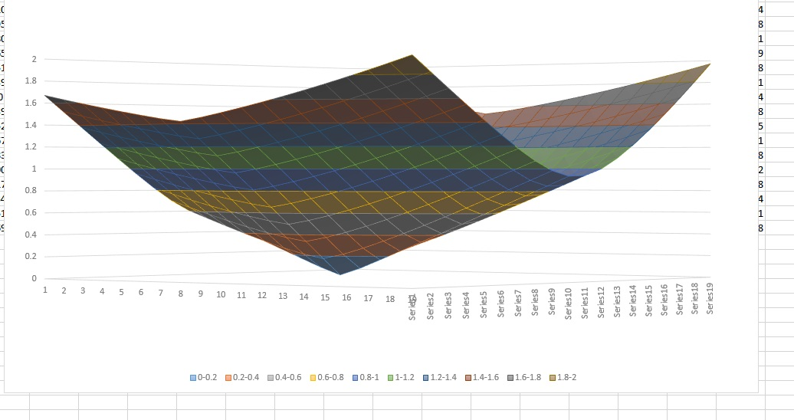
The shape of the objective function

Slide 8
Mesh Painting
There is no major issue with the coverages of the proper areas in the surface mesh
Report is ongoing
Is that a good idea to submit an abstract to EMACS2017?

Slide 9
How to make the objective function better
Coords
lengths
areas
Rates’ relation

Slide 10
Next Week Plans
Trying to import a mesh
- 8*8 or 16*16
- Exregion or exnode/exelem
+ Concluding on the optimization method
- test some more methods on a small problem … get a feel of them ,,,
+ send the plotted result of the 2D space today --- total objective …
+ Finding how to apply parallelisation
+ complete the report
+ submit the abstract (if it is not late)

